Slide 1

Domain: Cybersecurity and Machine Learning
By : Surenthiran S

Slide 2
Problem Statement
As a data scientist at Microsoft, I was tasked with enhancing the efficiency of Security Operation Centers (SOCs) by developing a machine learning model that can accurately predict the triage grade of cybersecurity incidents. Utilizing the comprehensive GUIDE dataset, your goal is to create a classification model that categorizes incidents as true positive (TP), benign positive (BP), or false positive (FP) based on historical evidence and customer responses.
TP - A legitimate threat that is detected, BP - A legitimate activity or process that is sometimes mistaken for a malicious threat and FP - An alert that suggests a potential threat but is actually harmless
The model should be robust enough to support guided response systems in providing SOC analysts with precise, context-rich recommendations, ultimately improving the overall security posture of enterprise environments.

Slide 3
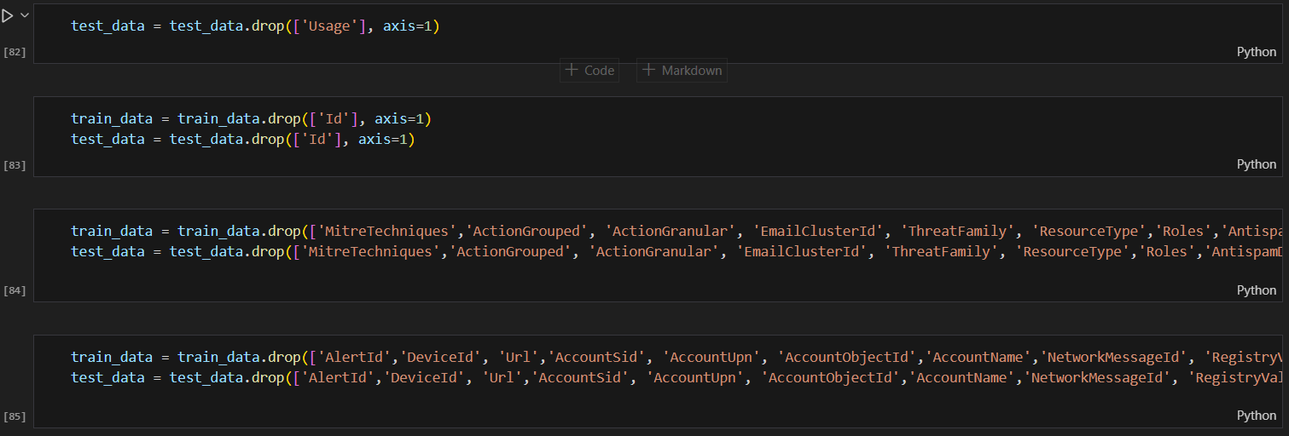
Data Cleaning & preprocessing
Handling Missing Data: Deleting null values in Incident Grade (Target Column) and dropping 10 Columns('Mitre Techniques ',’Action Grouped', 'Action Granular', 'Email Cluster Id', 'Threat Family', 'ResourceType','Roles','AntispamDirection','SuspicionLevel','LastVerdict') with more than 60% null values.

Slide 4
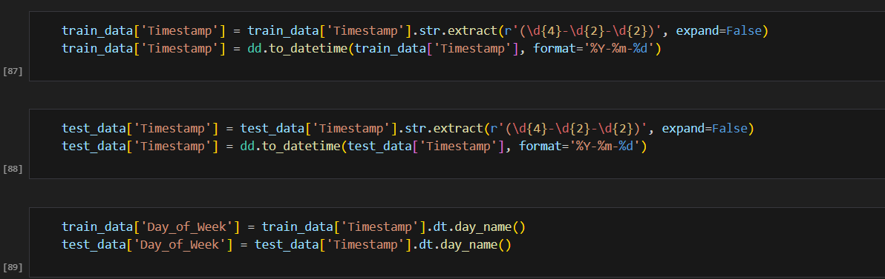
Feature Engineering: created a new feature ‘Day of week’ from the column ‘Time Stamp’.

Slide 5
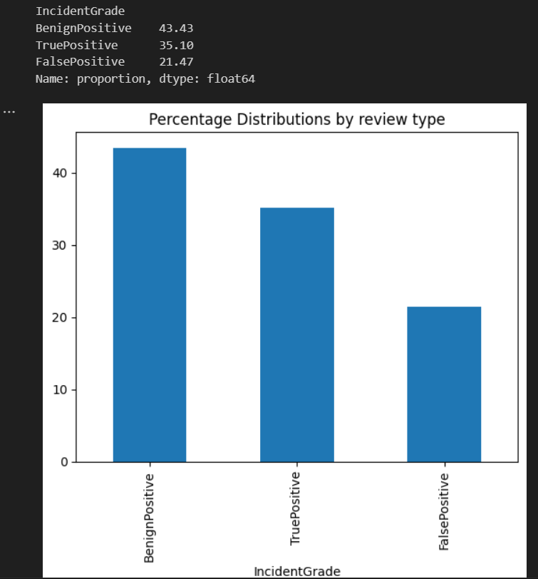
EDA

Slide 6
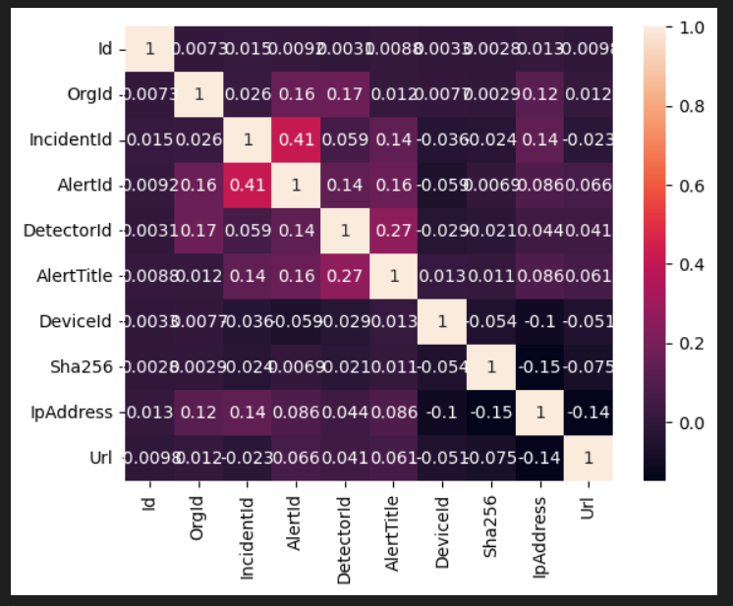
Correlation:

Slide 7
Removing features that are not significantly correlated. ('AlertId','DeviceId', 'Url','AccountSid', 'AccountUpn', 'AccountObjectId','AccountName','NetworkMessageId', 'RegistryValueName','RegistryValueData','OAuthApplicationId', 'ResourceIdName‘).

Slide 8
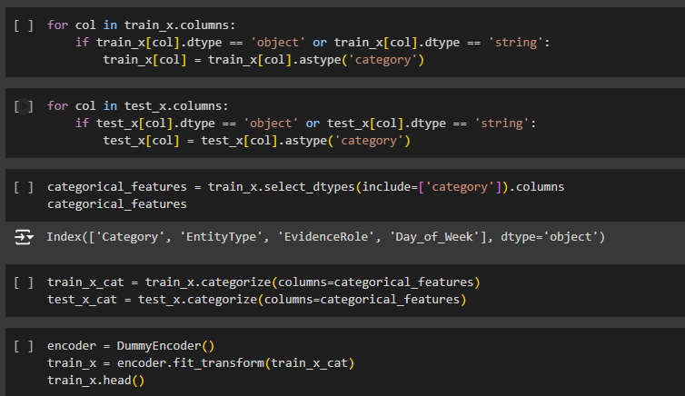
One Hot Encoding: Categorical to numerical column.

Slide 9
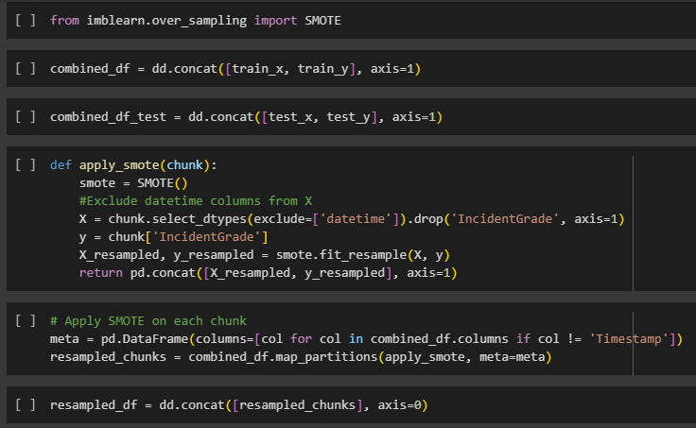
SMOTE

Slide 10
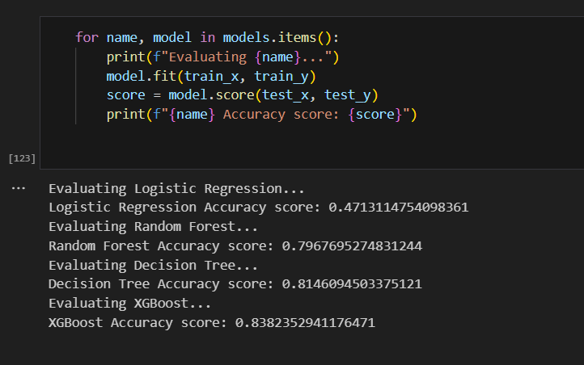
Model Evaluation

Slide 11
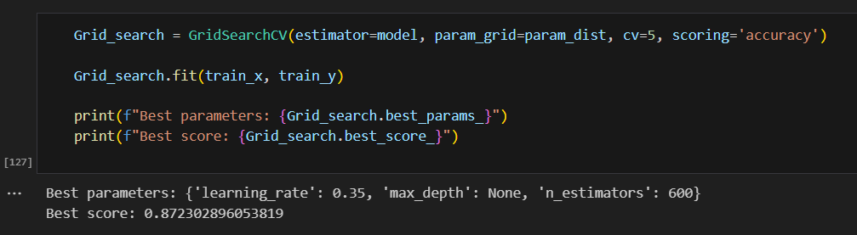
Hyper Parameter Tuning

Slide 12
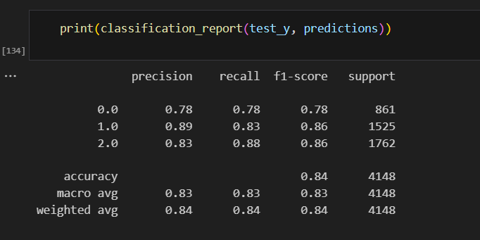
Final model report

